Slide 1

Empowering Women in the Fight Against HIV
An analysis of the UNICEF State of the World’s Children 2019 data set focusing on Adolescent HIV in Sub-Saharan Africa.
By Chris Clark for Math 5387 Applied Regression Analysis

Slide 2
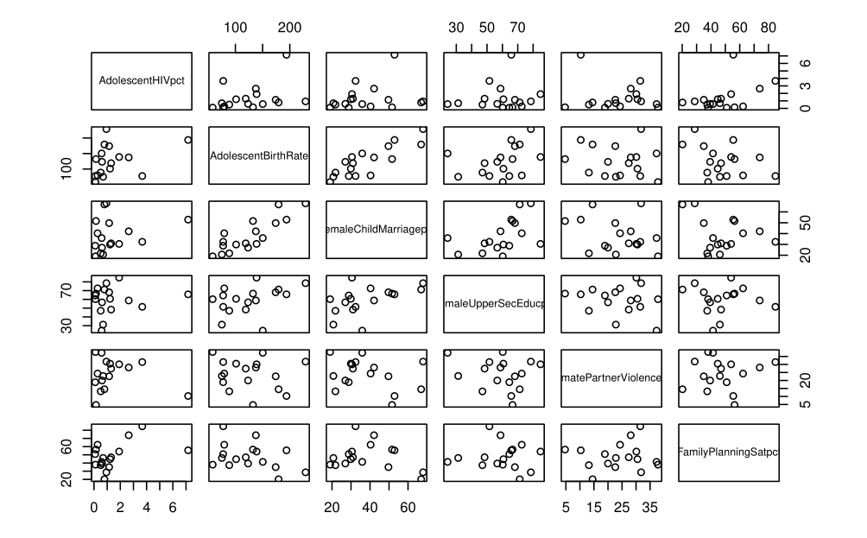
Preliminary Considerations and Data Visualization
Factors pulled from the data set: Fertility, Urban percent, Under 5 Childhood Mortality Rate, Adolescent Birth Rate, Female Upper-Secondary Education percent, Female Child Marriage percent, Justification of Wife Beating by Women percent, Intimate Partner Violence percent, Family Planning Satisfaction percent, and the Social Institutions and Gender Index (SIGI) score.
Region focused on: Sub-Saharan Africa

Slide 3
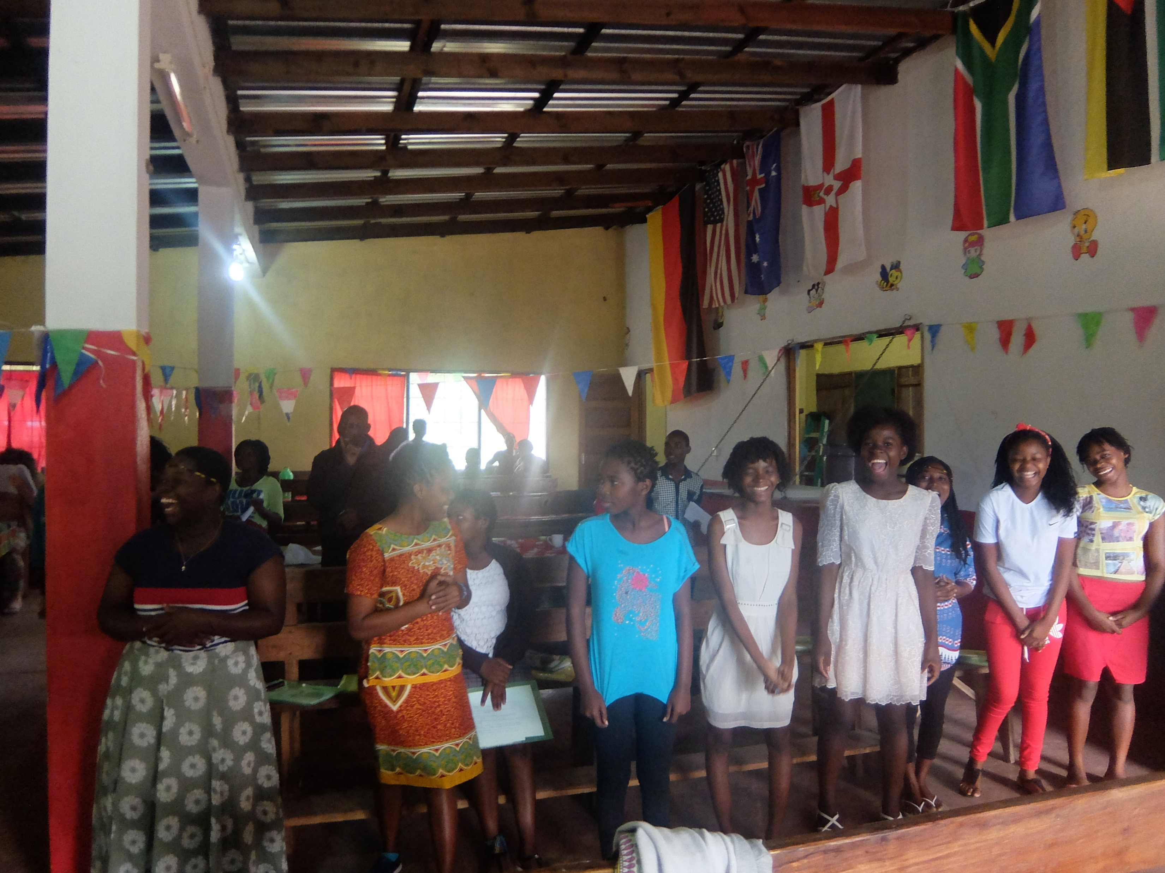
Our Final Model
$$\hat{log⁡(AdolescentHIVpct)}=−3.974014+0.013354 (AdolescentBirthRate) −0.006902 (JustificationWifeBeatingFemalepct) + 0.051221 (FamilyPlanningSatpct)$$
Interpretation:
If the adolescent birth rate (rate of births per 1000 women age 14-19) increases by 1, Adolescent HIV prevalence will increase by 1.344 %.
If the percent of women who agree that domestic violence is justified increases by 1 percent, Adolescent HIV will increase by 0.6878 %.
If the percent of women who are satisfied by the available family planning increases by 1 percent, the Adolescent HIV prevalence will increase by 5.265 %.

Slide 4
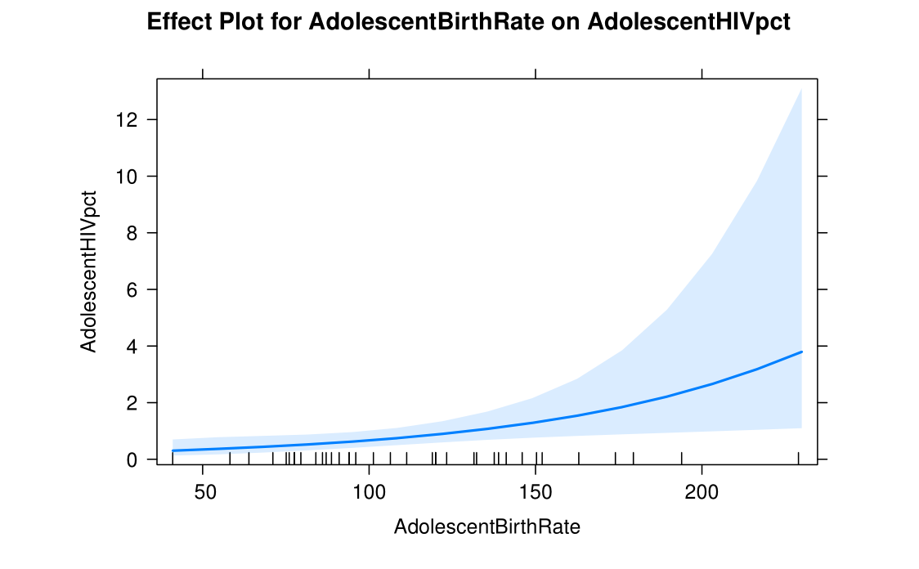
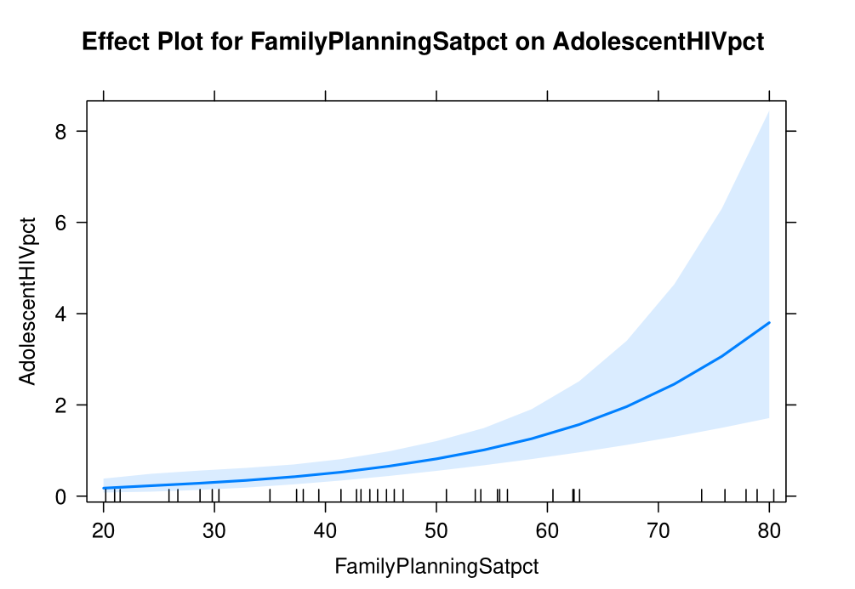
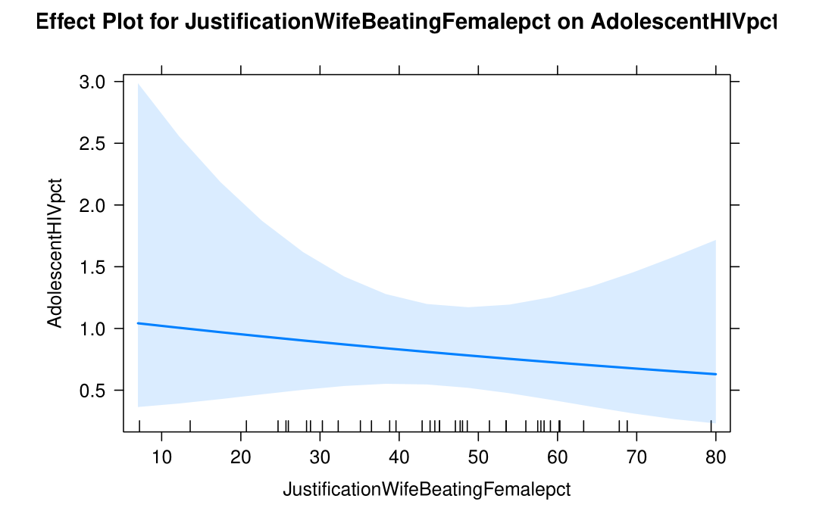
Effects Plots to Aid in Visualization
Interpretation:
The Effects Plots show the effect of each regressor on the original scale, assuming the other regressors remain fixed. This is the dark-blue line.
The light-blue bands are the confidence intervals. We are less certain about in these, as we encountered structural issues in creating our model that can affect these. However, this does not affect the dark-blue lines.

Slide 5
Impact on Policy and Future Research
Interesting Results
By focusing on reducing adolescent birth, which could mean reducing childhood marriages, increasing access to family planning for young women, promoting social norms that allow women to complete their education and delay sexual activity or marriage, and more should, according to our model, reduce Adolescent HIV. Similarly, promoting norms that reduce domestic violence and allow women more autonomy to choose when and with whom they engage in sexual activity should decrease Adolescent HIV.
The family planning satisfaction result is somewhat surprising. One might think that higher family planning satisfaction would imply more access to, and use of, prophylactics that would reduce Adolescent HIV. This is not what we find. However, a second interpretation is offered. In areas with low family planning satisfaction, it could be that there is little testing for HIV, as well. If this is the case, then our result makes more sense, as the true HIV prevalence might be hidden. Despite this confusion, this result gives us a direction for further research into why, if at all, family planning satisfaction is positively correlated with Adolescent HIV.
Finally, given that structural issues make us doubt our confidence intervals, re-fitting the model to address these faults will help us interpret better our results.

Slide 6
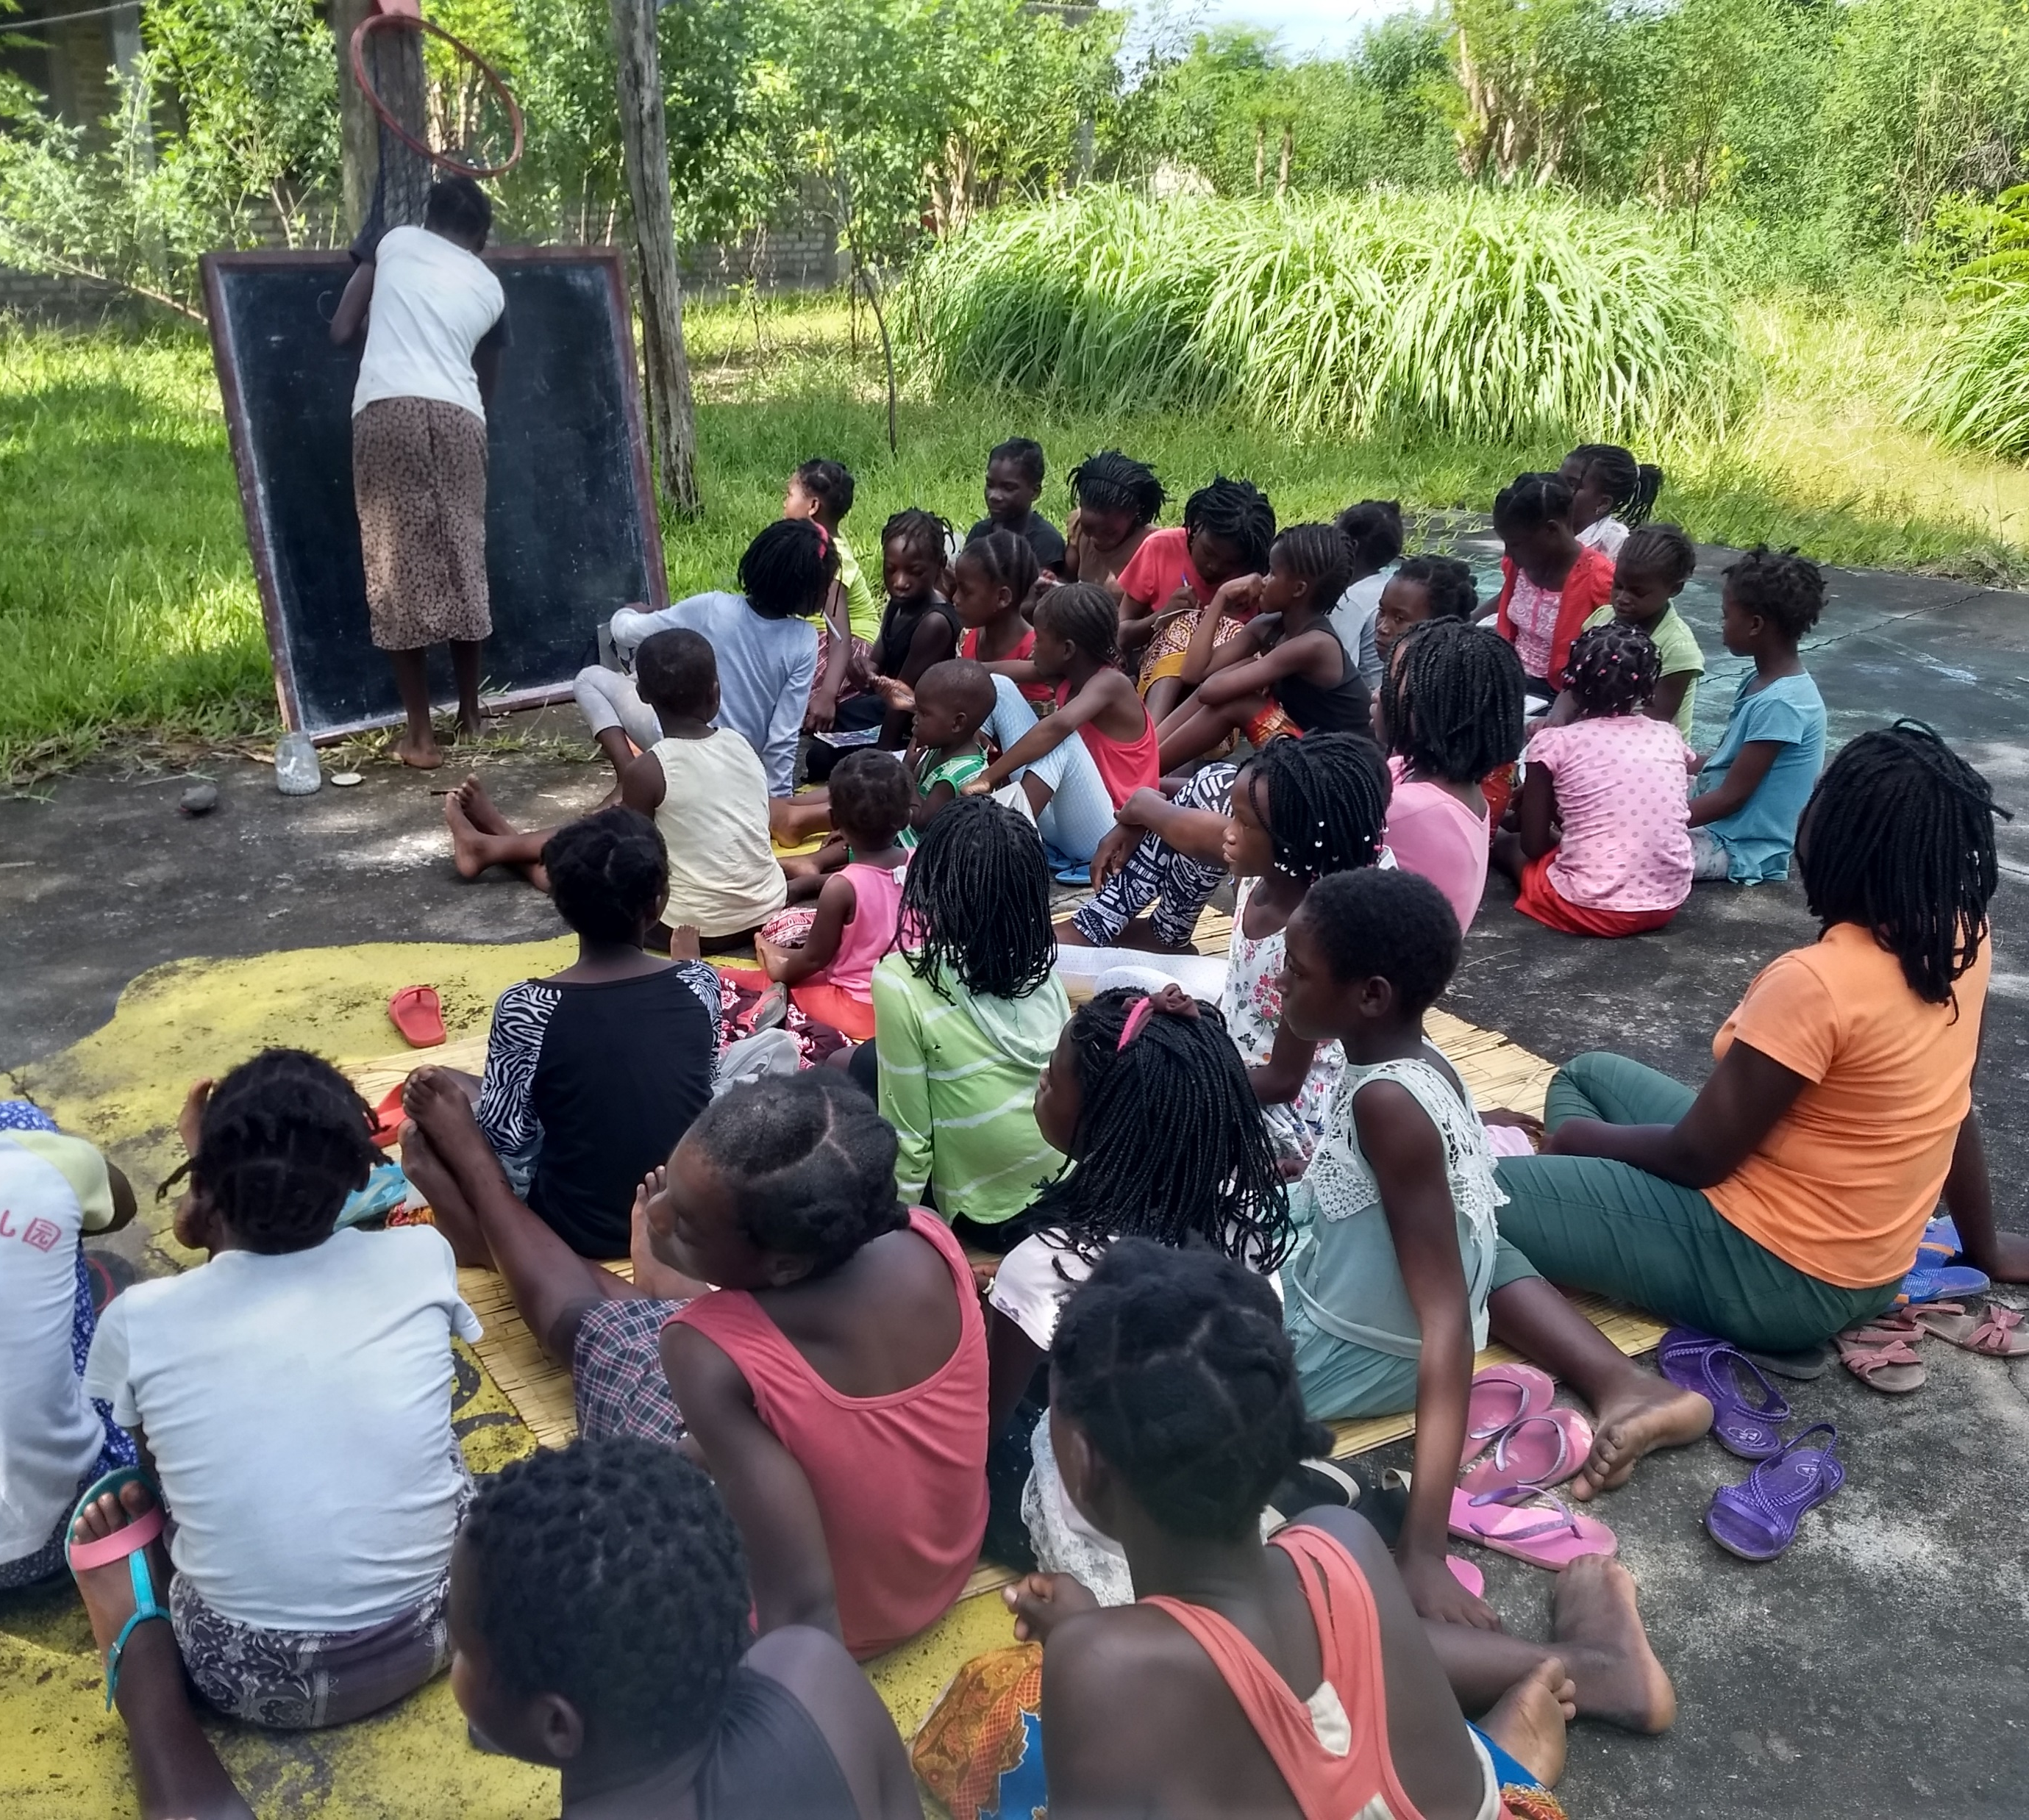
Conclusion
Women play a major role in the social dynamics of HIV, and by focusing on promoting women’s empowerment, education, bodily and sexual autonomy, and more, we can reduce Adolescent HIV in Sub-Saharan Africa. Though this research focuses on a particularly hard-hit region of the world, this researcher believes that if further research were to focus on other areas of the world, similar results would obtain.

Slide 7
Bibliography
UNICEF. (October 2019). The State of the World’s Children 2019 Statistical Tables. Retrieved from https://data.unicef.org/resources/dataset/sowc-2019-statistical-tables/
Photos taken during various Peace Corps-sponsored Raparigas em Desenvolvimento, Educação, e Saúde, or Young Women in Development, Education, and Health trainings and meetings in Mozambique from 2017-2018 by various Peace Corps Volunteers.

